Slide 1
Server-side
Web Programming
Lecture 5+:
Java Servlets and the
web.xml Configuration File

Slide 2
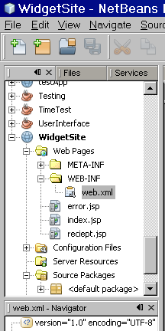
Configuration Files
Each webapp has a web.xml file
  In WEB-INF subdirectory
Defines:
  Mapping from servlet names to servlet files
  Global constants
  Default error pages
  Security roles…

Slide 3
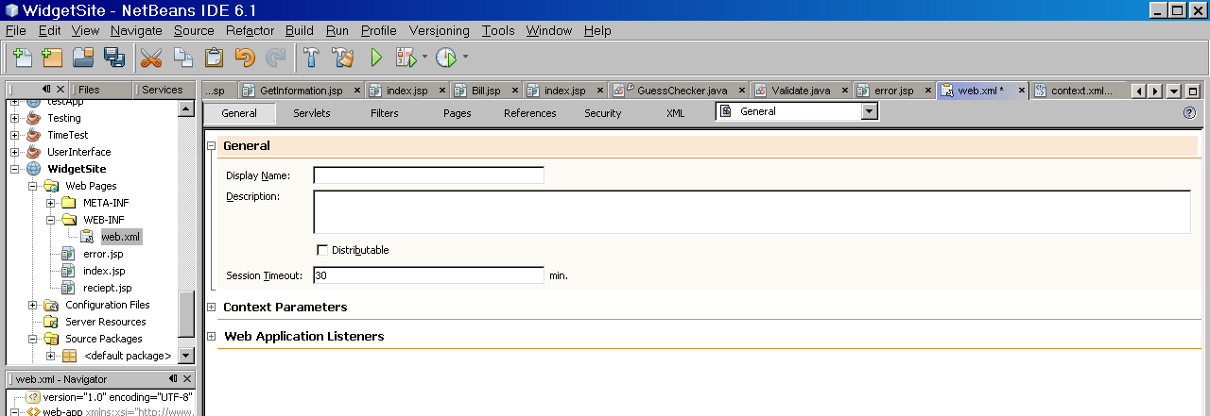
The web.xml file
Complex (and finicky) XML
If buggy, application will not load
  Errors displayed in Tomcat window when started
NetBeans provides interface to manipulate its values

Slide 4
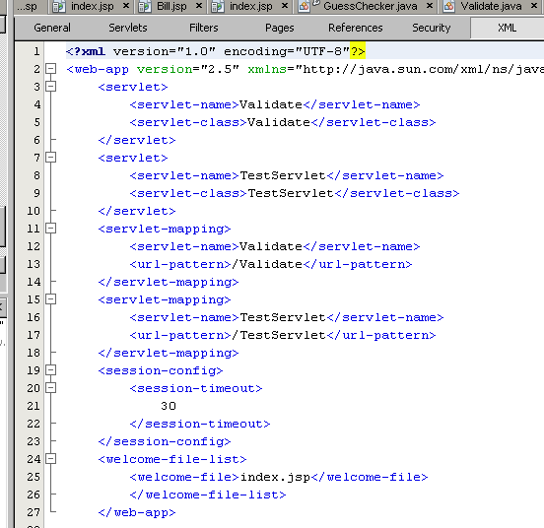
The web.xml file
Internally, still XML
  Can view and edit at XML tab
  Basic form of XML: <tag>text</tag> or <tag/>
  Tags must be properly balanced and nested
  Must have a root tag <webapp>

Slide 5
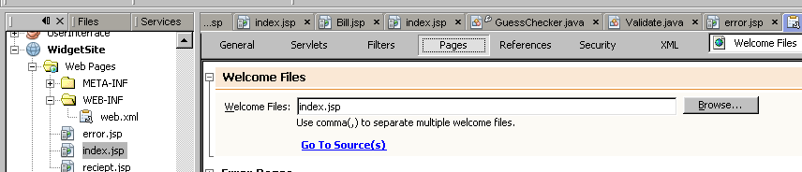
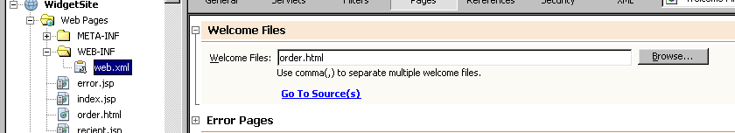
Welcome Page Properties
Page shown at webapp startup
  Default: index.jsp
Can change to a new welcome file

Slide 6
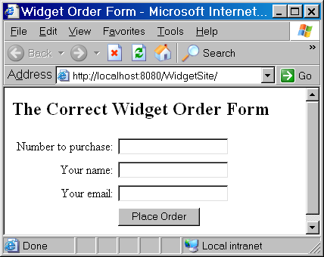
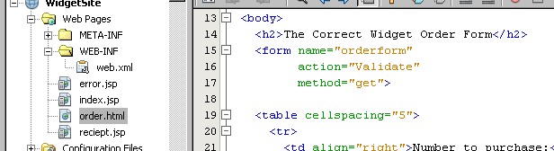
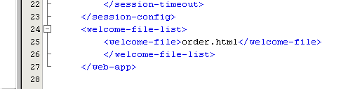
New Welcome Page
Will go to that page when webapp started
Note change in web.xml

Slide 7
Servlet Mapping
Web.xml links referrer page to be linked with actual servlet class
Mapping from a name to a java class
  Allows servlet code to be changed without having to rewrite other pages
    Important since name of class = name of file in Java
Mapping from a url pattern to a servlet name
  Allows servlets to be “hidden” from user
Referring file that
invokes servlet
web.xml
url pattern → name
name → servlet class
Java servlet class
with actual code
url pattern used
in FORM ACTION

Slide 8
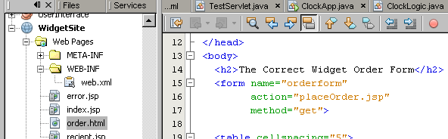
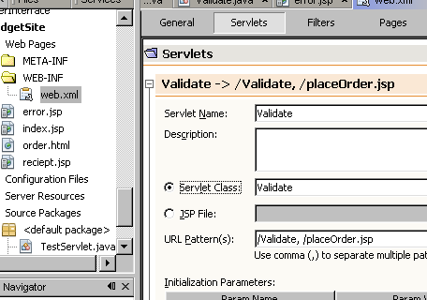
Servlet Mapping
No such file – this is just a url pattern that will refer to an actual servlet via web.xml
Added to the url patterns that map to this servlet

Slide 9
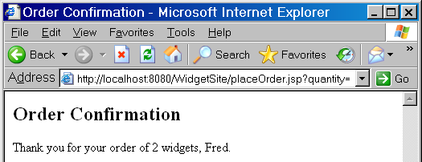
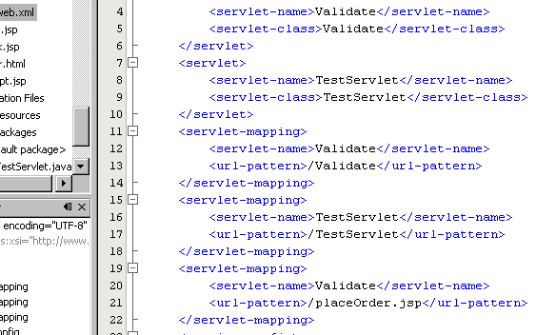
Servlet Mapping
Note that the url pattern appears in the browser
Code in web.xml that does the servlet mapping

Slide 10

Initial Parameters
Global constants stored in web.xml
  Better than “hardwiring” values directly into the code
    Easier for nonprogrammer to modify
  Form like parameter: name/value
    Example: “price per unit” in widget site
  Note that such information is usually in a database
  However, the name of the database is often an initial parameter!
web.xml
pricePerUnit=9.95
Java servlet class
that needs widget cost

Slide 11
Initial Parameters
Configuration level
  Specific to single servlet
Context level
  General to all server pages/servlets
overall application context
…
context-level parameters
SomeServlet‘s configuration
configuration-level parameters
SomeServlet object
AnotherServlet‘s configuration
configuration-level parameters
AnothereServlet object

Slide 12
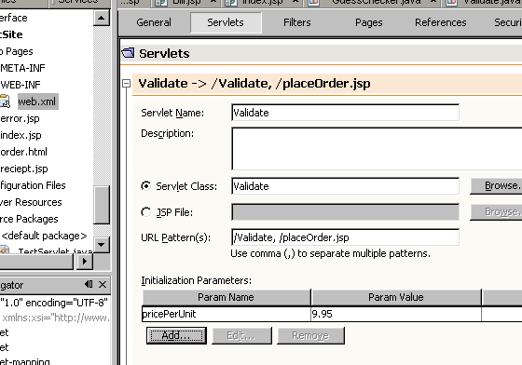
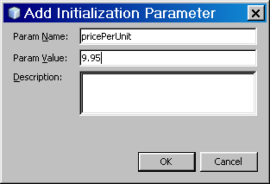
Configuration Parameters
Can create in servlet tab

Slide 13
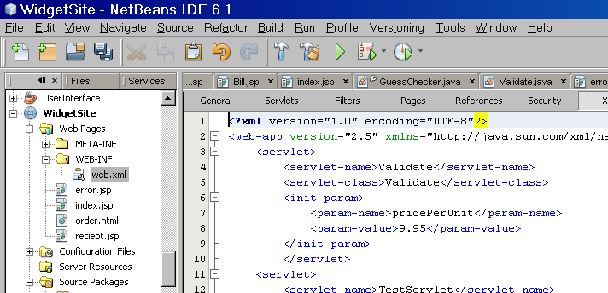
Configuration Parameters
Form of xml tag

Slide 14
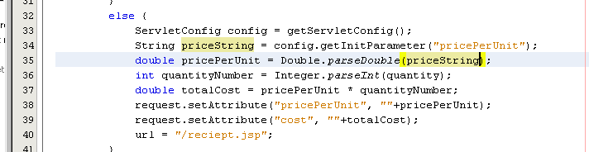
Configuration Parameters
Accessing from servlet:
  Get the servlet configuration
  ServletConfig config = getServletConfig();
  Get the value corresponding to the name of the parameter
  String value = config.getInitParameter(“name");

Slide 15
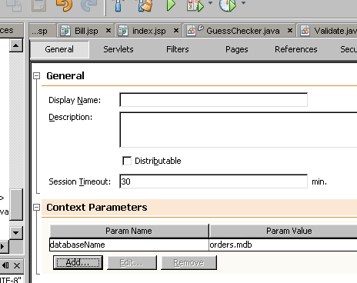
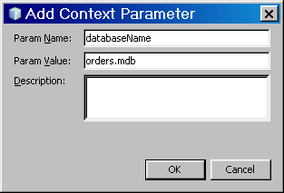
Context Parameters
Can create in general tab

Slide 16
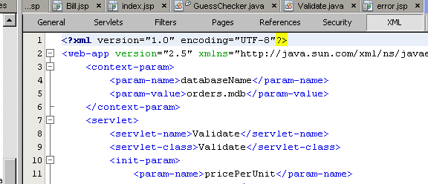
Context Parameters
Form of xml tag

Slide 17
Configuration Parameters
Accessing from servlet:
  Get the servlet configuration
  ServletConfig config = getServletConfig();
  Get the webapp context from the configuration
  ServletContext context = config.getServletContext();
  Get the value corresponding to the name of the parameter
  String value = context.getInitParameter(“name");
Accessing from a JSP:
  String value = application.getInitParameter(“name");
Built-in object in JSP
(like “request”)

Slide 18
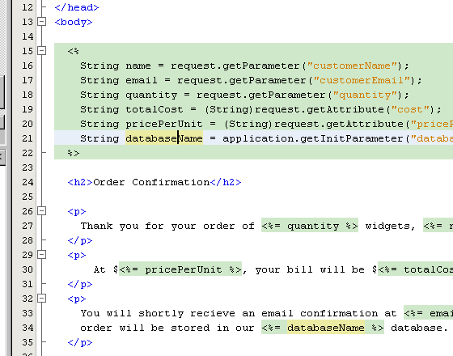
Configuration Parameters

